Slide 1

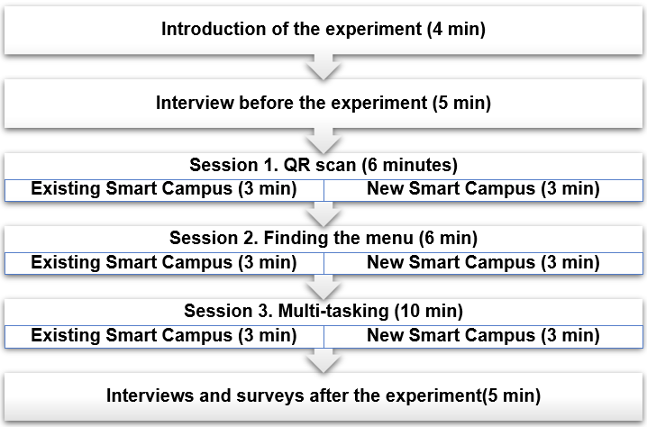
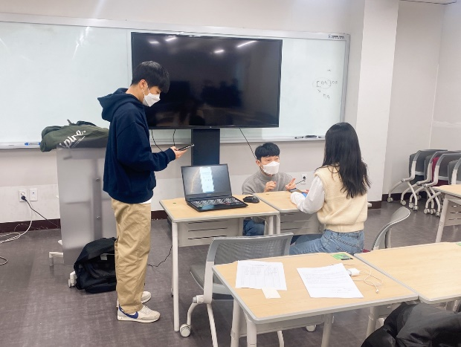
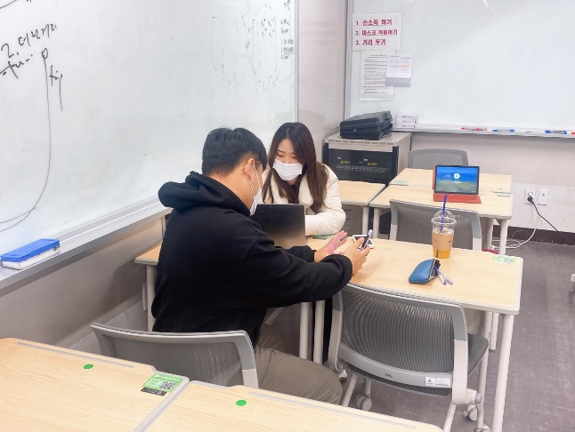
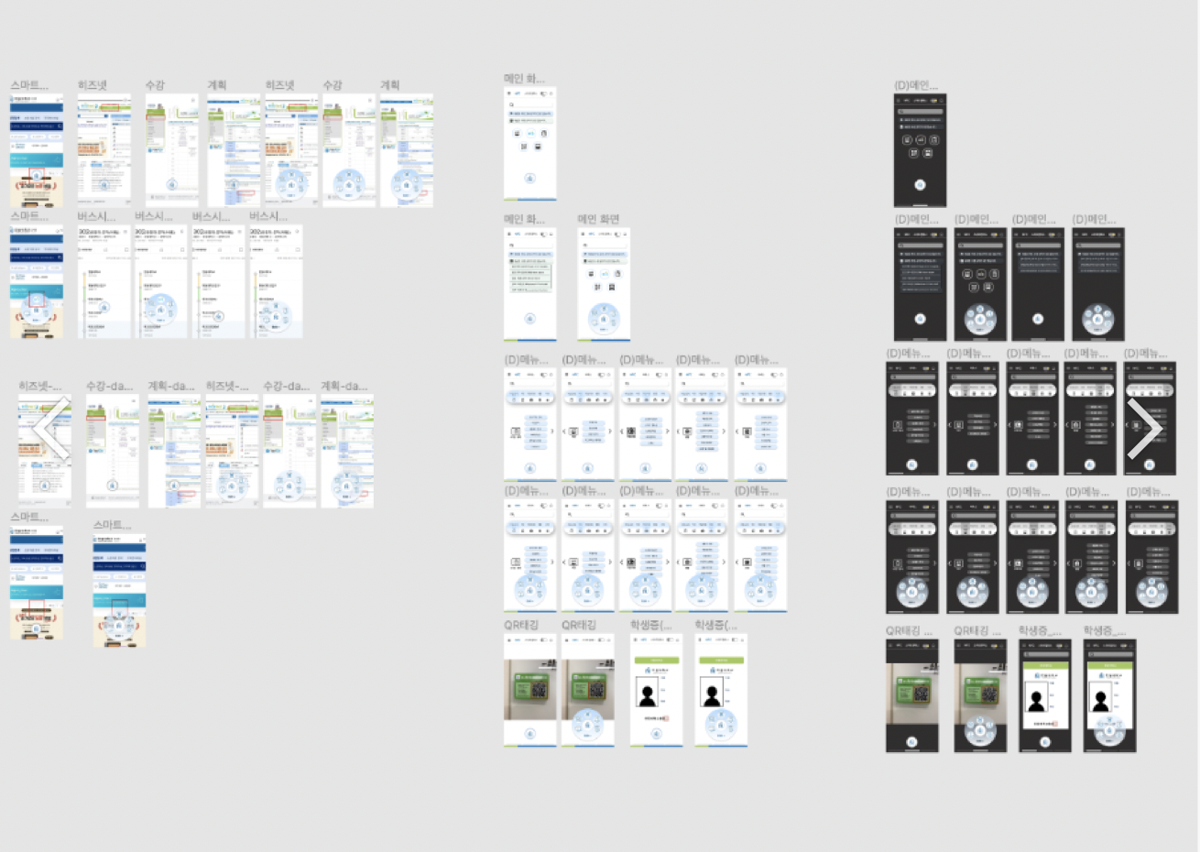
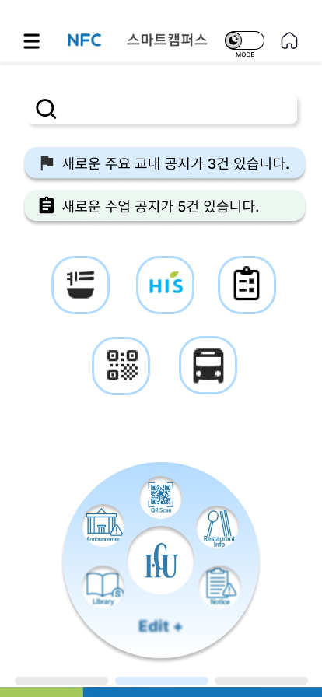
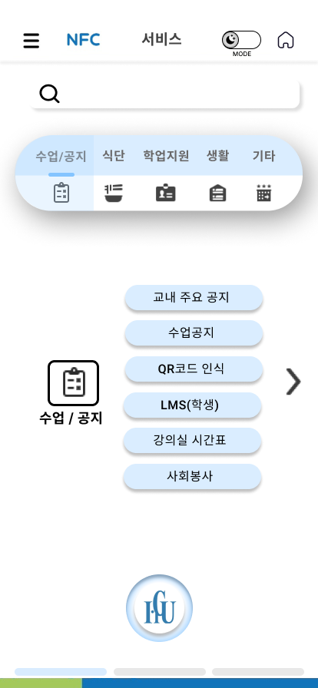
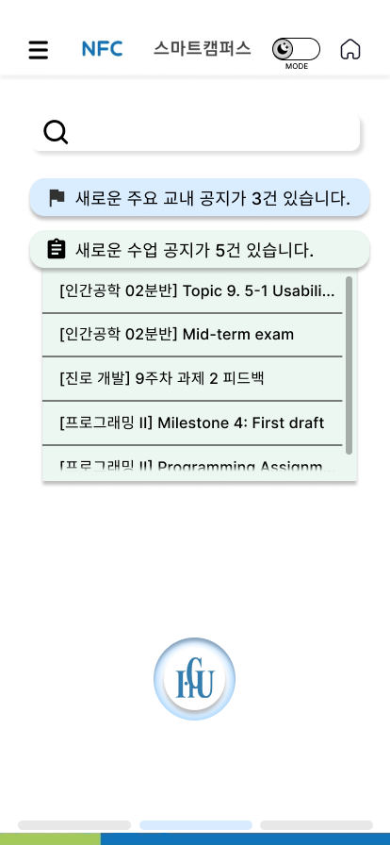
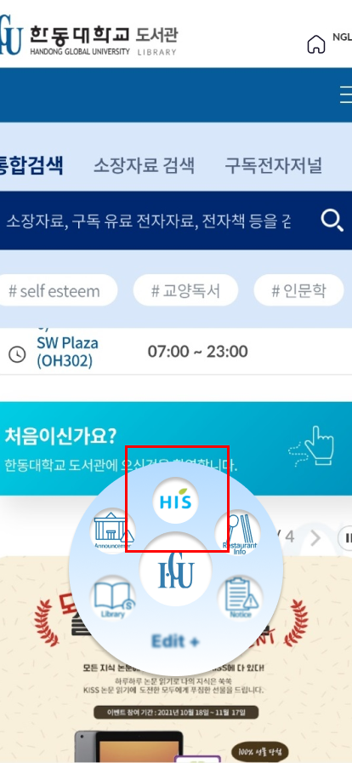
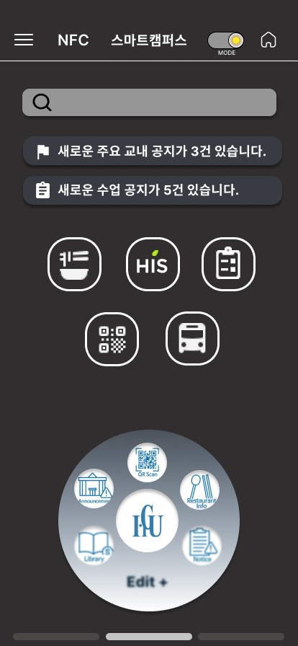
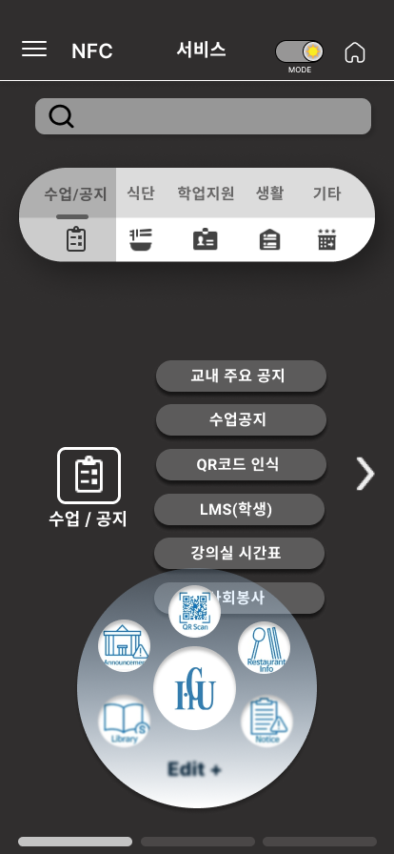
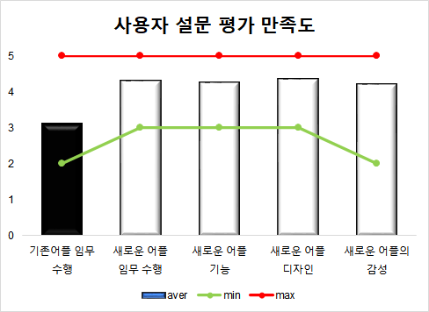
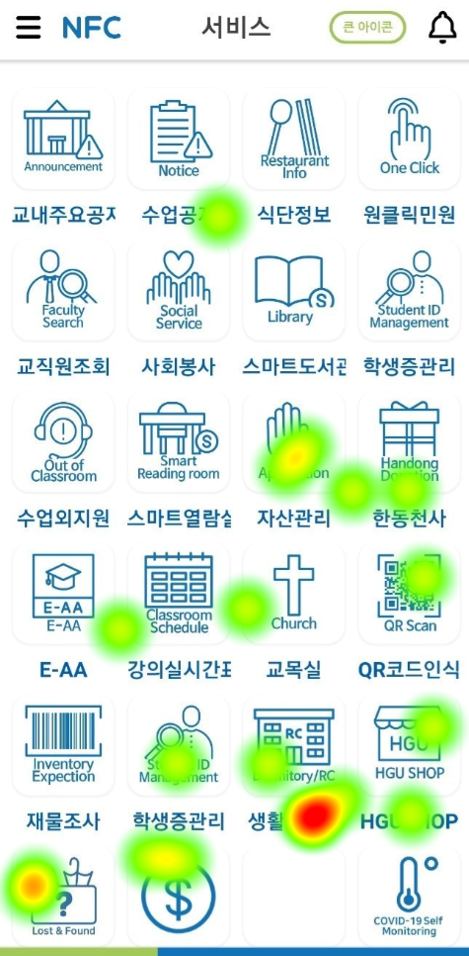
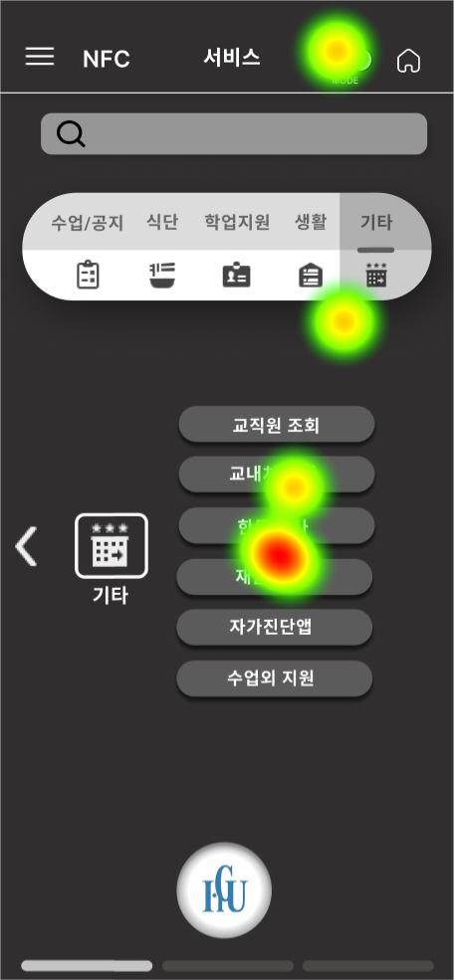
Developing Smart Campus Application
Four Five 뽀빠이 / Team 05
21300543 Seungyoo Lee,21700475 Huichan Yu, 21800720 Hyojung Chun, 21800795 Juwon Hong
Topic & Background
: Redesigning the "Smart Campus(스마트캠퍼스)" app structure
Experiments (User Test)
Participants : 20 people who use Smart Campus application
Usability
problems
Discoverability
Simplicity
Flexibility
Consistency
1) Natural sciences : 8 people
2) Liberal arts: 8 people
3) Mixed: 4 people
Procedure
Purpose
1. Correction that causes cognitive errors (human error)
2. Adding a new function that considers the usability problems
Measures
1) Quantitative: Time checking, Eye tracker, Survey
2) Qualitative: Pre-Post Interview
Analysis
<Figma_Overview>
Quantitative Analysis
2. Satisfaction
< Usability test chart >
1. Time on task
< Eye-Tracker Data >
Conclusion
Contribution
Limitation
Expected Further Studies
Collecting 20 Handong students' opinions, finding problems of previous version of Smart Campus Application and proposing redesigned prototype and asking feedback and satisfaction level.
The design of prototype was more intuitive but as people adapted to the new design, it took more time and eye fatigue was higher in the eye tracker
Accuracy of Eye tracker was low
Provide detailed information of Icons for students who want intuitive information structure
Reduce the number of functions that students do not use
When Smart Campus Application linked to Hisnet/Library provide appropriate Crawling
Previous Ver.
Redesigned Ver.
2) Qualitative Analysis
Good
1. Able to customize quick menu Useful
2. Intuitive design Accessibility & Discoverability
3. Category classification Efficiency
4. Dark mode Relieves eye fatigue
Bad
1. Need detailed Information of icon
2. Still too many functions
3. Crawling doesn't work when it linked to Hisnet/Library
4. Large size of Quick menu

